Slide 1
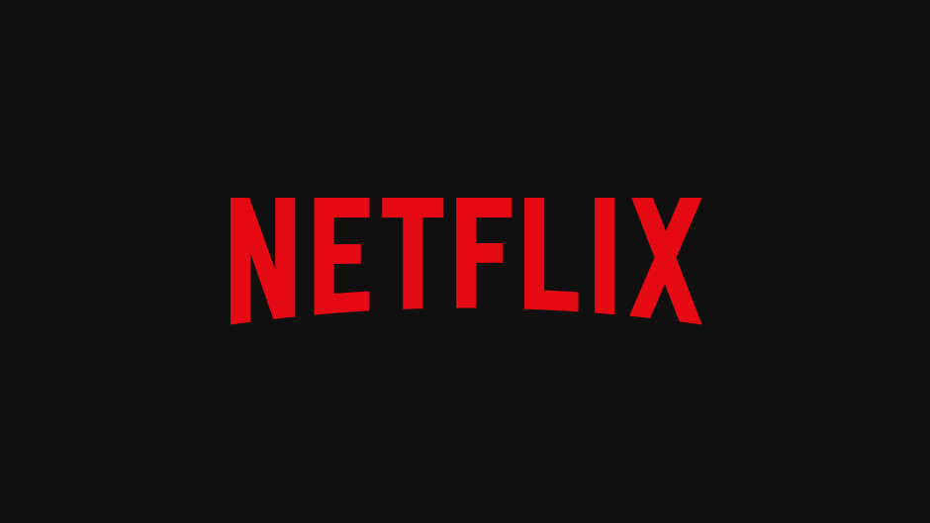
Applying Bus Fundamentals Learnings | a deep dive
Akanksha Srivastava | 2023204019
Mansi Somani | 2023201028
Saurabh Mishra | 2023201034
Sougata Mitra | 2024204006

Slide 2
Content
Netflix as a Company
Netflix Journey & key milestones
Competitive Landscape
SWOT Analysis
Netflix as a Product
Product Life Cycle journey & current phase
Product Features & key differentiators
Kano model on OTT Features
User survey insights Primary Research
Conjoint Analysis
Customer centric vs Product centric design
Netflix as a Business
Strategy for Growth
India Strategy

Slide 3
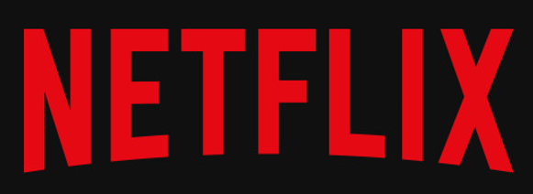
Vision statement: “Becoming the best global entertainment distribution service”
Market Share 39% vs 29% Amazon Prime
Available in 190+ Countries
230M Subscribers
2.4K Original Titles Largest collection
Revenue $33.7B
Operating Margin 18%
Market Cap: $304B
at a glance
A pioneer in streaming and a leader in Entertainment business offering a vast library of original and licensed content

Slide 4
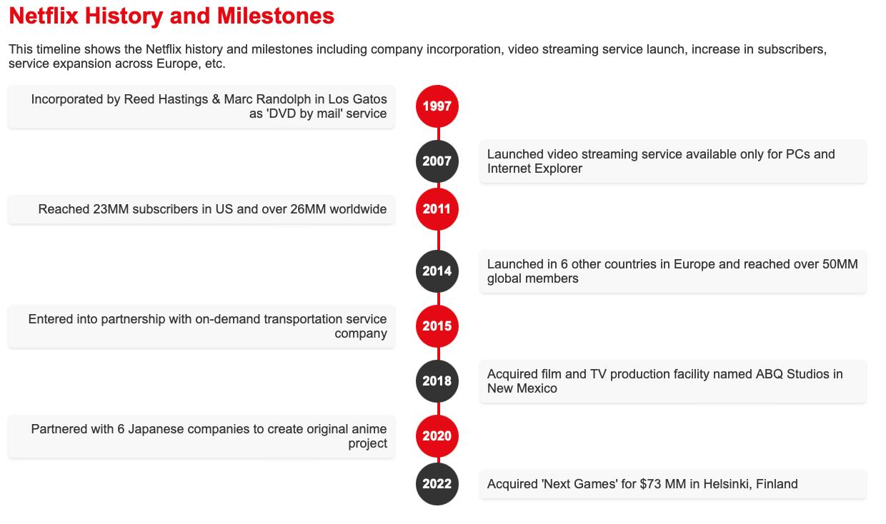

Slide 5
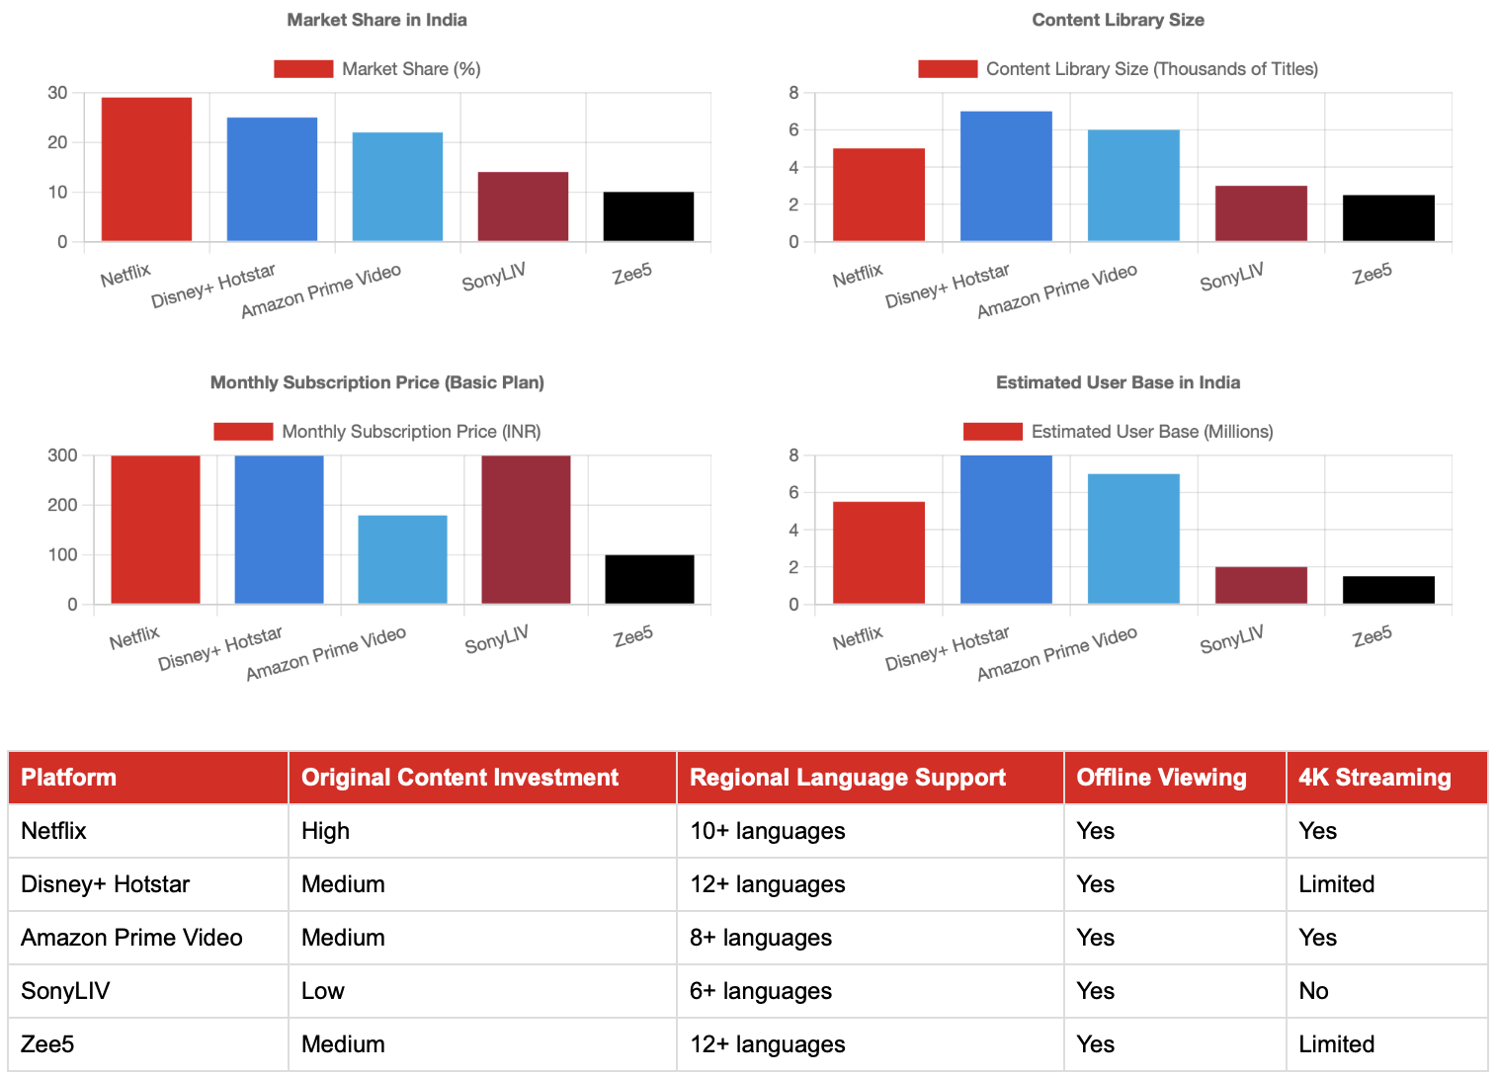
Netflix's Competitive Landscape in India
Netflix leads in content library size and has a competitive market share, despite having the highest subscription price.
Disney+ Hotstar has the largest estimated user base, likely due to its diverse content offering including sports.
Amazon Prime Video offers a balanced proposition with a large content library and competitive pricing.
SonyLIV and Zee5 are smaller players but offer unique regional content and competitive pricing.
Netflix invests heavily in original content, which may justify its premium pricing strategy.

Slide 6
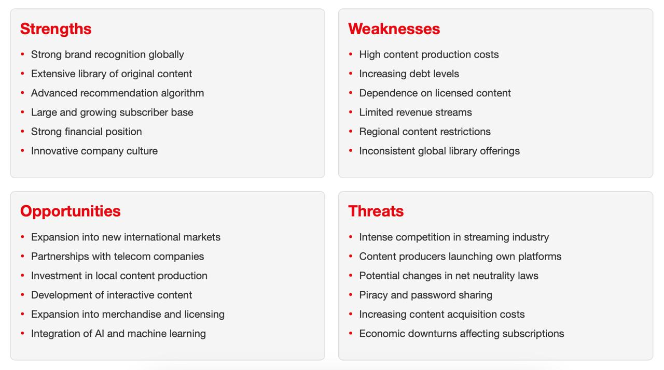
SWOT Analysis of NETFLIX

Slide 7
Netflix as a Product

Slide 8
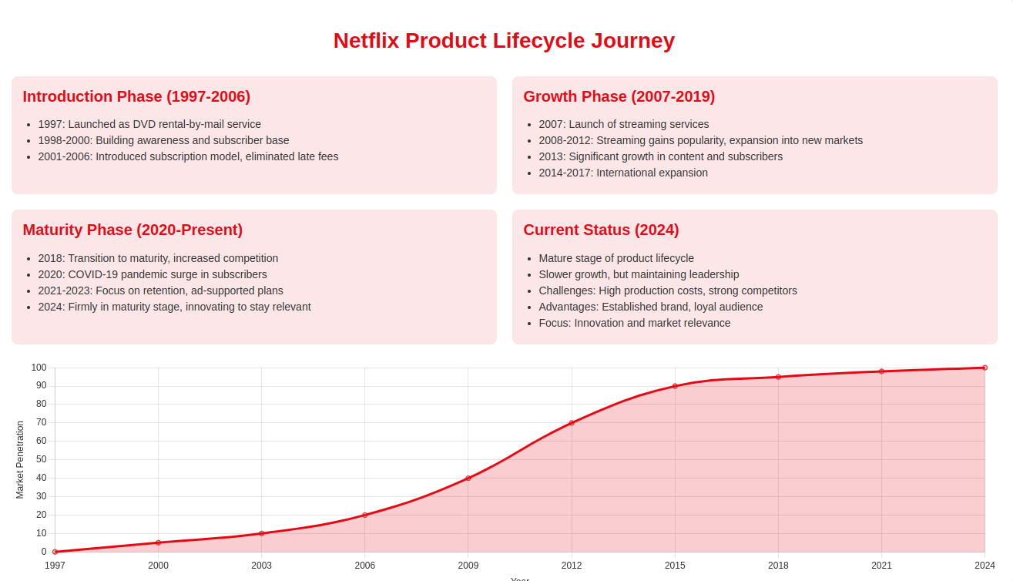

Slide 9
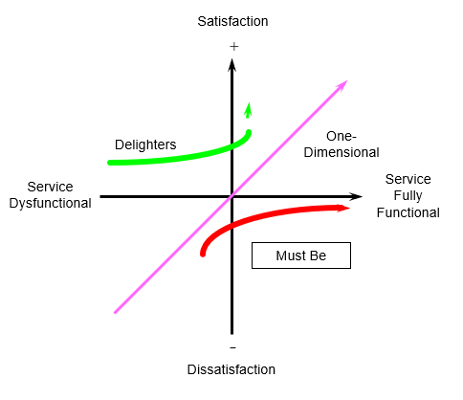
How customers value OTT Platform Features Kano model
Ad-free experience
Affordable Pricing
Content with HD/4K quality
Simultaneous streaming / how many devices
Personalized Recommendation
Original content
Exclusive Live/Special events coverage
Content Availability
Acceptable Streaming Quality
Account Security
Multi-device support
Easy to use User Interface
Indifferent: UI customisation, Gaming Add-Ons
Negative:
Forced Autoplay, Invasive Data collection
Content restriction by Geo location

Slide 10

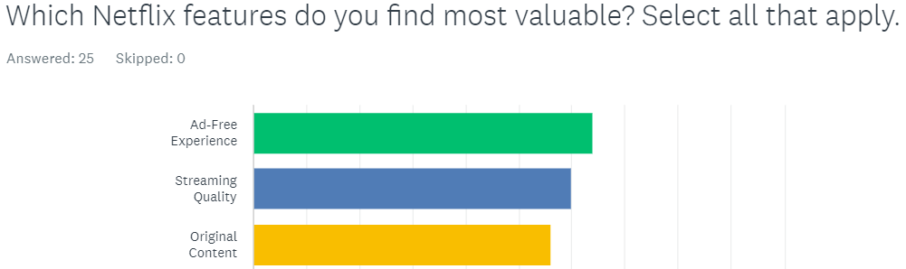
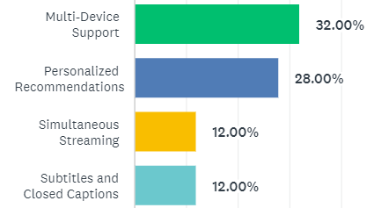
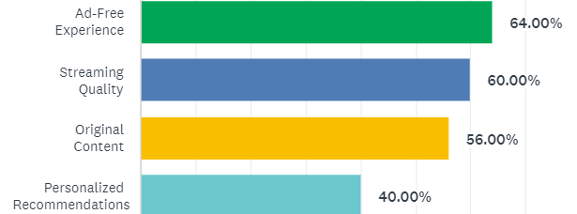
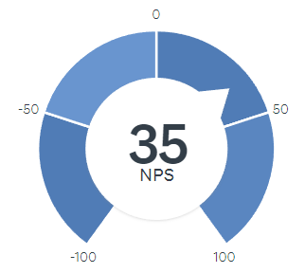
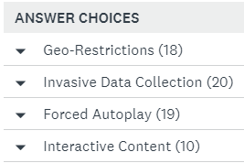
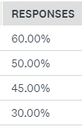
User survey insights on Netflix Features Primary Research: 25 Survey responses
Net Promoter Score

Slide 11
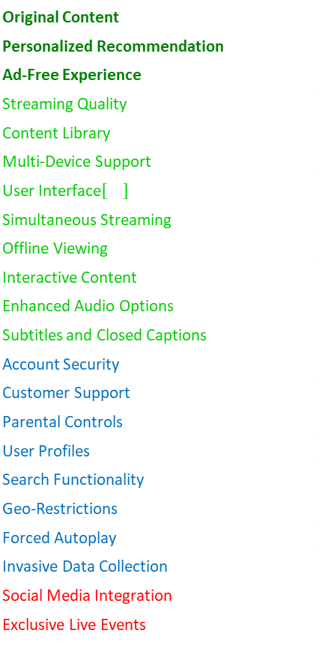
How Netflix is uniquely placed by its platform Features
Largest Original Content library, Advanced Personalisation & 100% Ad-free exp for all paid plans are strong “delighters”
Strong in most “Satisfiers” that matter to customers
Original Content
Personalized Recommendation
Ad-Free Experience
Streaming Quality
Content Library
Multi-Device Support
User Interface
Simultaneous Streaming
Offline Viewing
Interactive Content
Enhanced Audio Options
Subtitles and Closed Captions
Account Security
Customer Support
Parental Controls
User Profiles
Search Functionality
Geo-Restrictions
Forced Autoplay
Invasive Data Collection
Social Media Integration
Exclusive Live Events
Leader
Strong
Standard
Weak

Slide 12
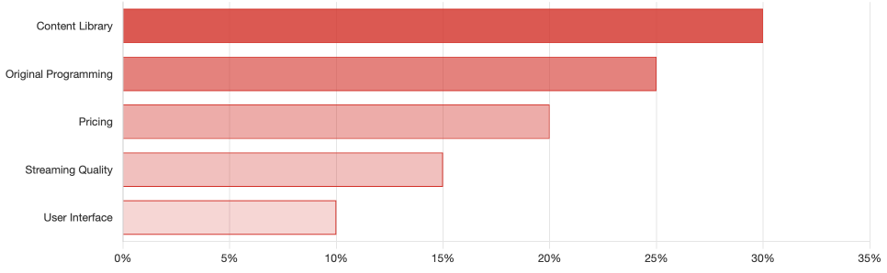
Conjoint Analysis Netflix Features
Content Library (30%) is the most critical factor for subscribers.
Original Programming (25%) closely follows, highlighting the importance of exclusive content.
Pricing (20%) plays a significant role in user decisions.
Streaming Quality (15%) and User Interface (10%) contribute to the overall experience.
This analysis guides Netflix's strategy in Resource allocation and Feature prioritization.

Slide 13
Where Does Netflix Stand Today in the PDLC Journey?
As of now, Netflix is firmly in the mature stage of its product journey. It’s not growing as quickly as before, but it's working hard to stay on top.
Netflix is dealing with the challenges of high production costs for original shows and movies and the rise of strong competitors. But its well-established brand and loyal audience give it an edge.
While its growth may have slowed down, Netflix is far from done innovating and finding ways to stay relevant in the entertainment industry.
Netflix’s focus today is on maintaining its leadership position by continuing to offer great content, exploring new markets and experimenting with different subscription options.

Slide 14
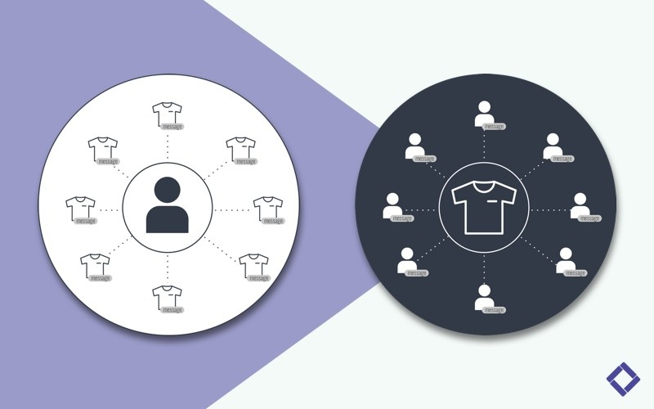
Business Orientation (Customer Centric vs. Product Centric)
Customer-Centric Approach: Prioritizes understanding and meeting customer needs, personalizing experiences, and refining services based on feedback.
Product-Centric Approach: Emphasizes developing innovative and high-quality products, focusing on unique offerings like original content.
Objective: Determine if Netflix's overall strategy leans more towards customer-centricity or product-centricity, using company practices and market data.

Slide 15
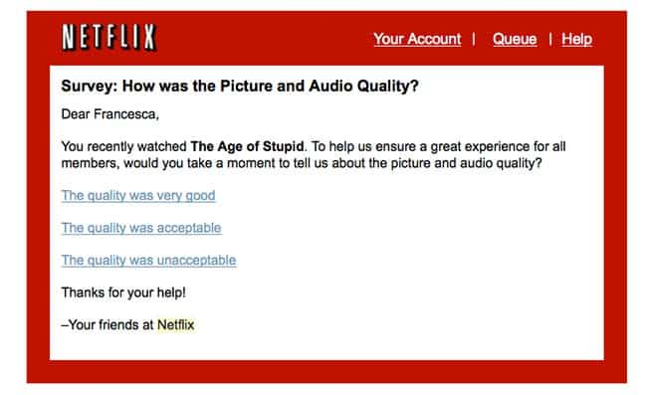
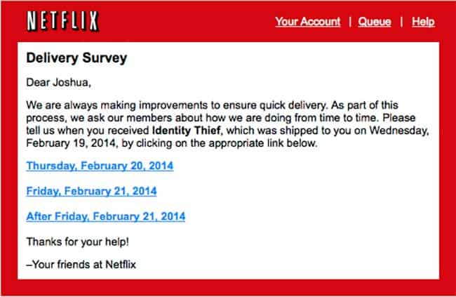
Netflix’s Customer-Centric Strategy
Personalization: Detailed explanation of Netflix’s use of data analytics to personalize content and recommendations.
Customer Service Initiatives: Highlight on 24/7 support, proactive account management (like email about service disruptions), and focus on customer joy.
Feedback and Adaptation: How Netflix uses consumer science, A/B testing, and adapts based on feedback (e.g., reversing unpopular decisions like the Qwikster split).

Slide 16


Netflix’s Product Innovations
Technological Innovations: Development of streaming technology and continuous interface improvements.
Content Strategy: Emphasis on creating original content to cater to diverse global tastes and maintaining control over the product pipeline.
Market Response: Adaptations to market challenges like the introduction of high-quality streaming during the pandemic.

Slide 17
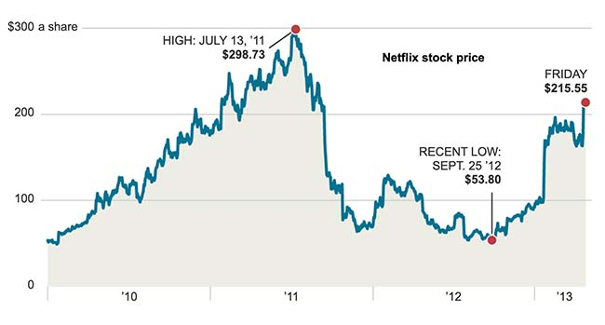
Analysis of Strategic Focus
Balancing Customer and Product Focus: Discussion on how Netflix’s innovations serve to enhance customer experience.
Examples of Customer-Driven Decisions: Case studies like the response to the 2011 backlash, and strategies for enhancing content accessibility and relevance.
Product Developments Driving Customer Satisfaction: How product decisions are fundamentally aimed at improving customer satisfaction and retention.

Slide 18

Conclusion
Summary: Recap that Netflix shows a strong customer-centric orientation by using product innovations primarily to enhance customer experience.
Final Assessment: Netflix is predominantly customer-centric, viewing its products as tools to fulfill and anticipate customer desires effectively.

Slide 19
Netflix STRATEGY for GROWTH

Slide 20
Recommendations for increasing User Engagement
Exclusive Content Access
Unlock exclusive content based on engagement levels
Incentivize regular platform usage
Create sense of exclusivity and reward
VR/AR Content
Produce original VR/AR content
Develop immersive experiences for popular shows
Position Netflix at forefront of emerging tech
Attract tech-savvy users and open new revenue streams
Enhanced Social Features
Integrate in-app messaging and commenting
Create watch groups for scheduled viewing sessions
Enhance user engagement through community interaction
Encourage organic content discovery via friends' activities
Enable shared experiences for remote co-watching
Differentiate Netflix with immersive social integration
Akanksha Srivastava

Slide 21
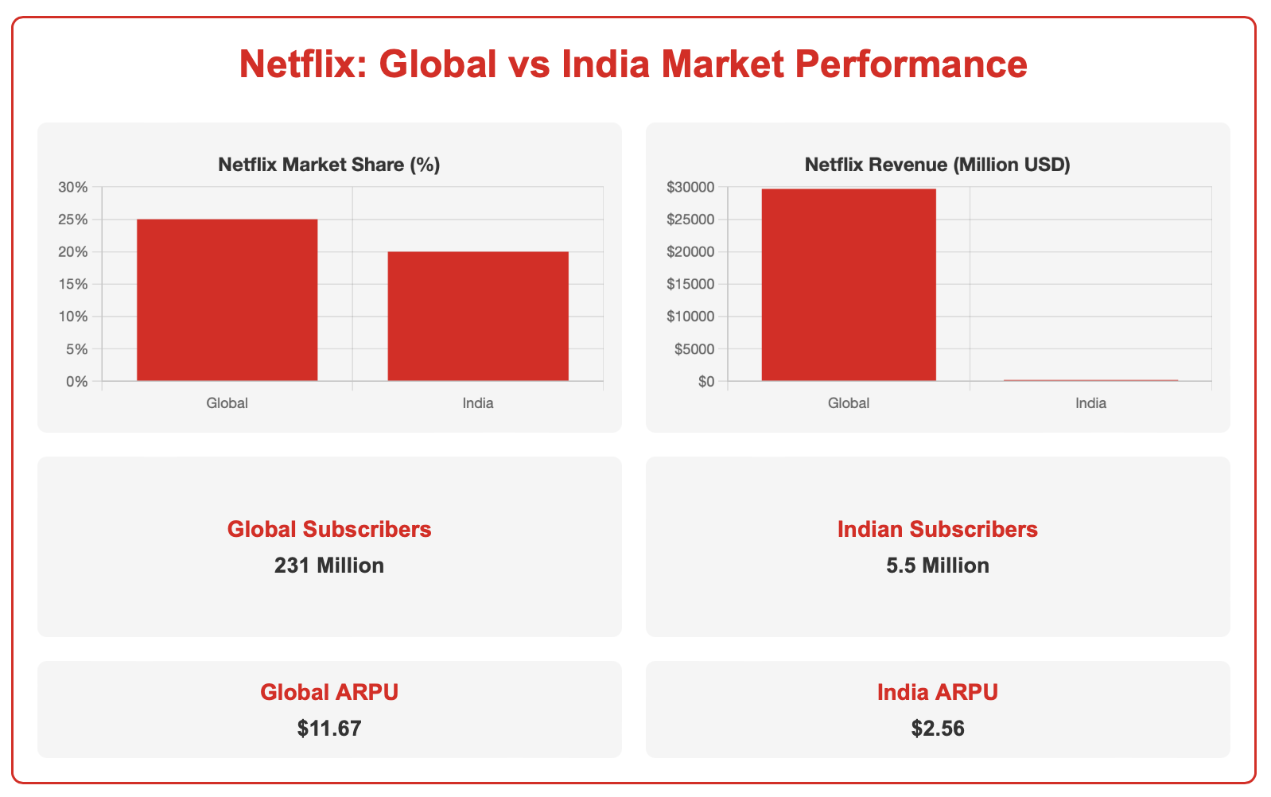
India Strategy for Growth
Netflix holds a strong 25% global market share, while capturing 20% in India
Global Revenue ($29.7B) dwarfs Indian revenue ($200M), highlighting the vast growth potential in India.
With 231 million global subscribers vs 5.5 million in India, Netflix has penetrated only a fraction of India's potential market
The stark difference in ARPU (Global: $11.67, India: $2.56) underscores the pricing challenges in India.
1
Netflix should consider more flexible, affordable pricing tiers to address the low ARPU and increase market penetration.
Invest in partnerships with local telecom providers and digital payment platforms to improve accessibility and ease of subscription.
2

Slide 22
Bibliography
1. Netflix. (2024). Company Information.
2. Statista. (2024). Netflix - Statistics & Facts.
3. Forbes. (2024). Netflix.
4. Harvard Business Review. (2023). Netflix Case Studies.
5. CNBC. (2024). Netflix News.
6. The Verge. (2024). Netflix Technology News.
7. Deloitte. (2023). Technology, Media & Telecommunications Predictions.
8. PwC. (2023). Global Entertainment & Media Outlook.
9. Hockeystick (2024) - Netflix Growth Chart
10. Medium (2024) - Netflix Life Cycle
11. Simplilearn (2024) - Netflix Marketing Strategy
12. Productboard (2021) - Netflix Customer Centric Product Strategy
13. Fortune India (2024) - Netflix India Strategy
14. The Business Model Analyst (2024) - Netflix SWOT Analysis

Slide 23
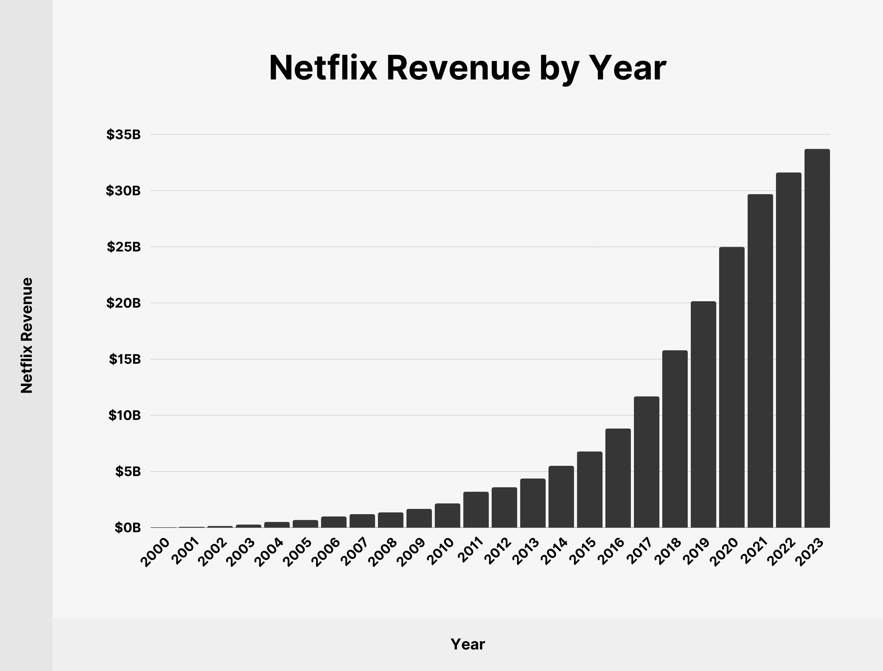
Appendix

